Slide 1
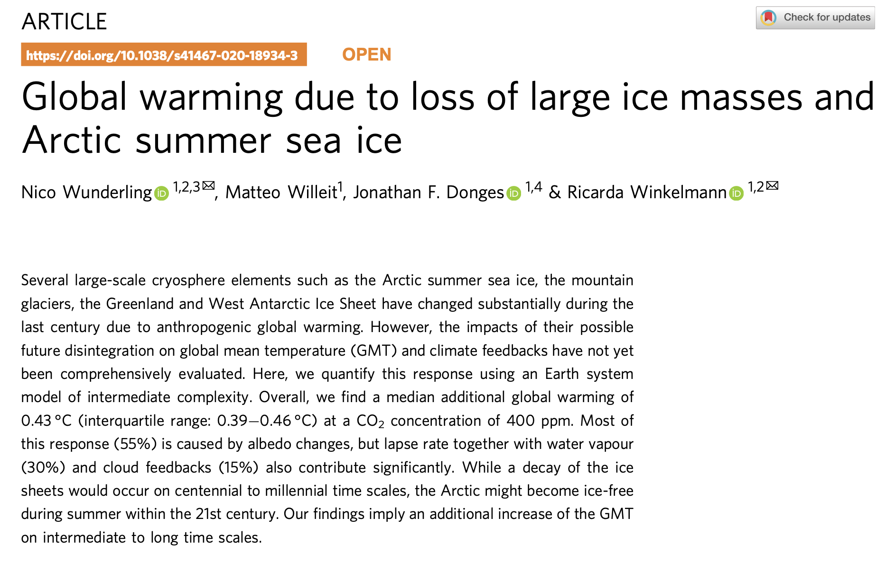
The designers of Cambio (Neshyba, Eklof, et al) used Wunderling et al to figure out how much albedo reduction will result from a given amount of warming.

Slide 2
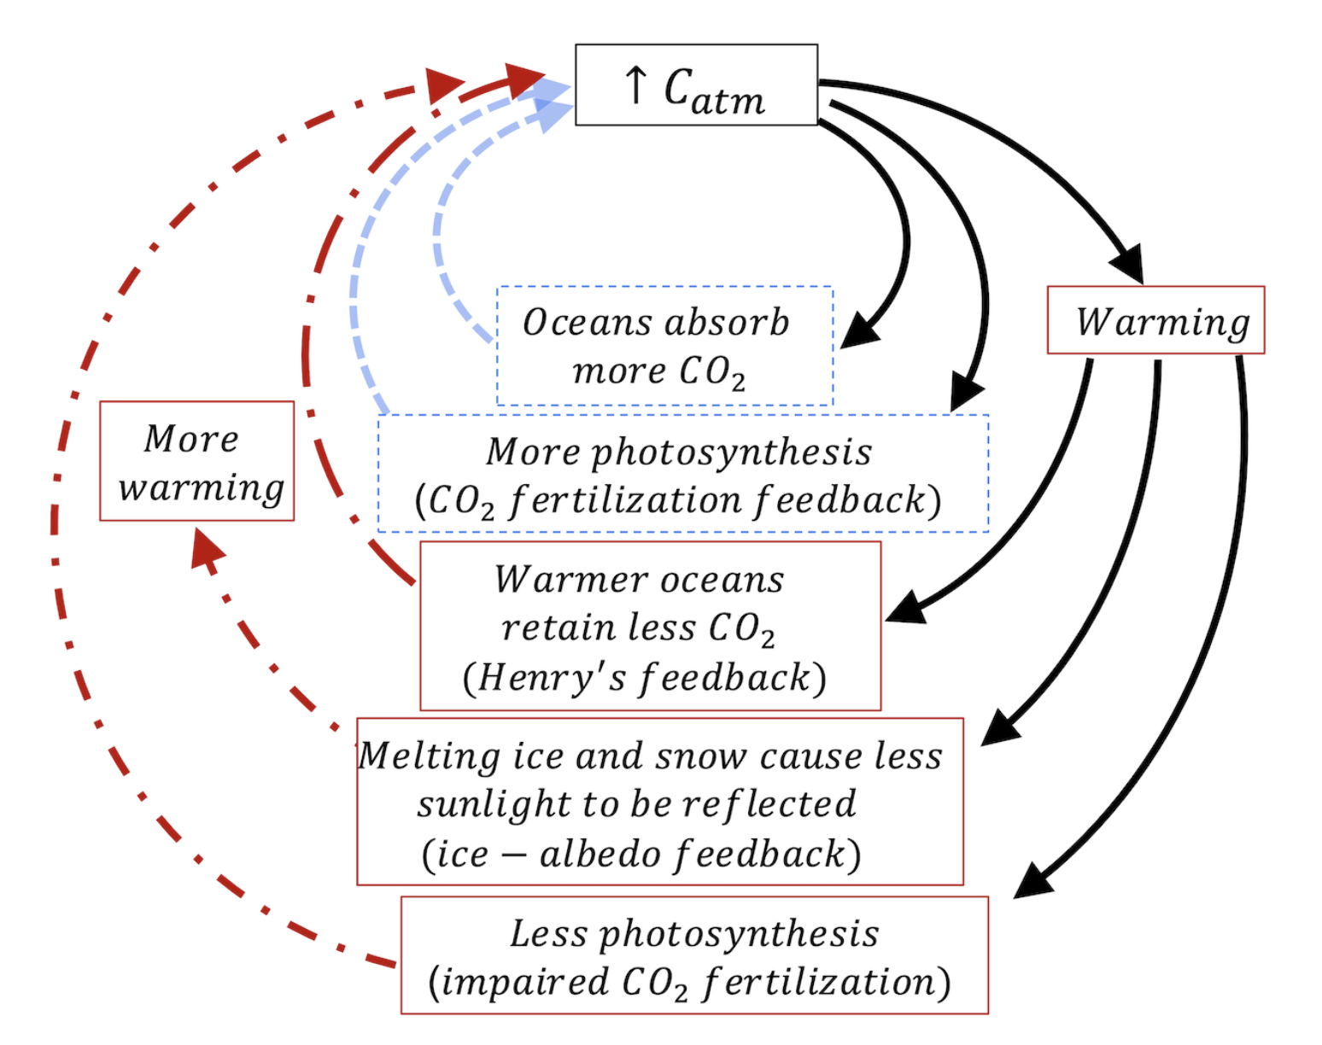
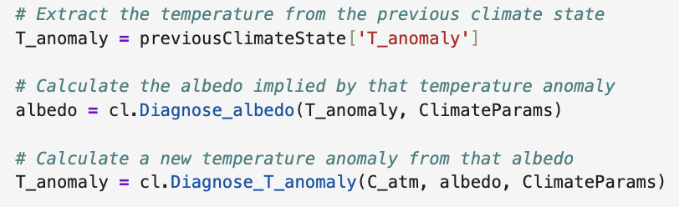
Cambio 3.0 accounts for ice-albedo feedback inside the propagator
1
2
3
…

Slide 3
In Step 1, we get the temperature anomaly from the dictionary of the previous state
1
2
3
…
1

Slide 4
In Step 2, we compute an albedo from that temperature anomaly
1
2
3
…
2

Slide 5
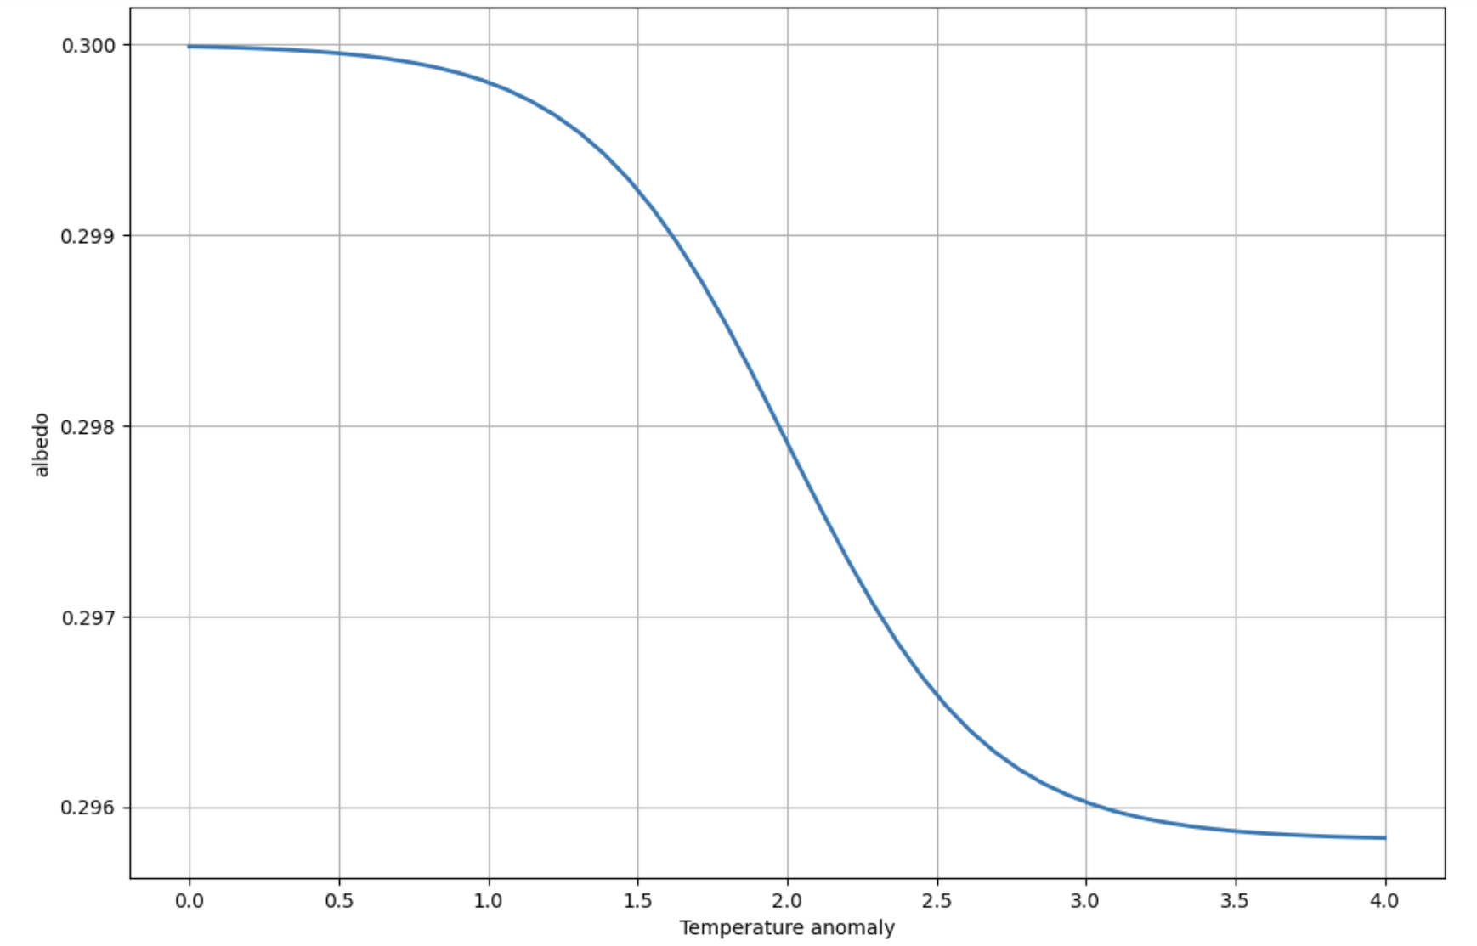


Code, graphics, and math of Step 2 …
Here’s the code we just saw
Here’s what it does graphically
Here’s what it does mathematically

Slide 6
In Step 3, we compute a temperature anomaly from the (new) albedo
1
2
3
…
3

Slide 7
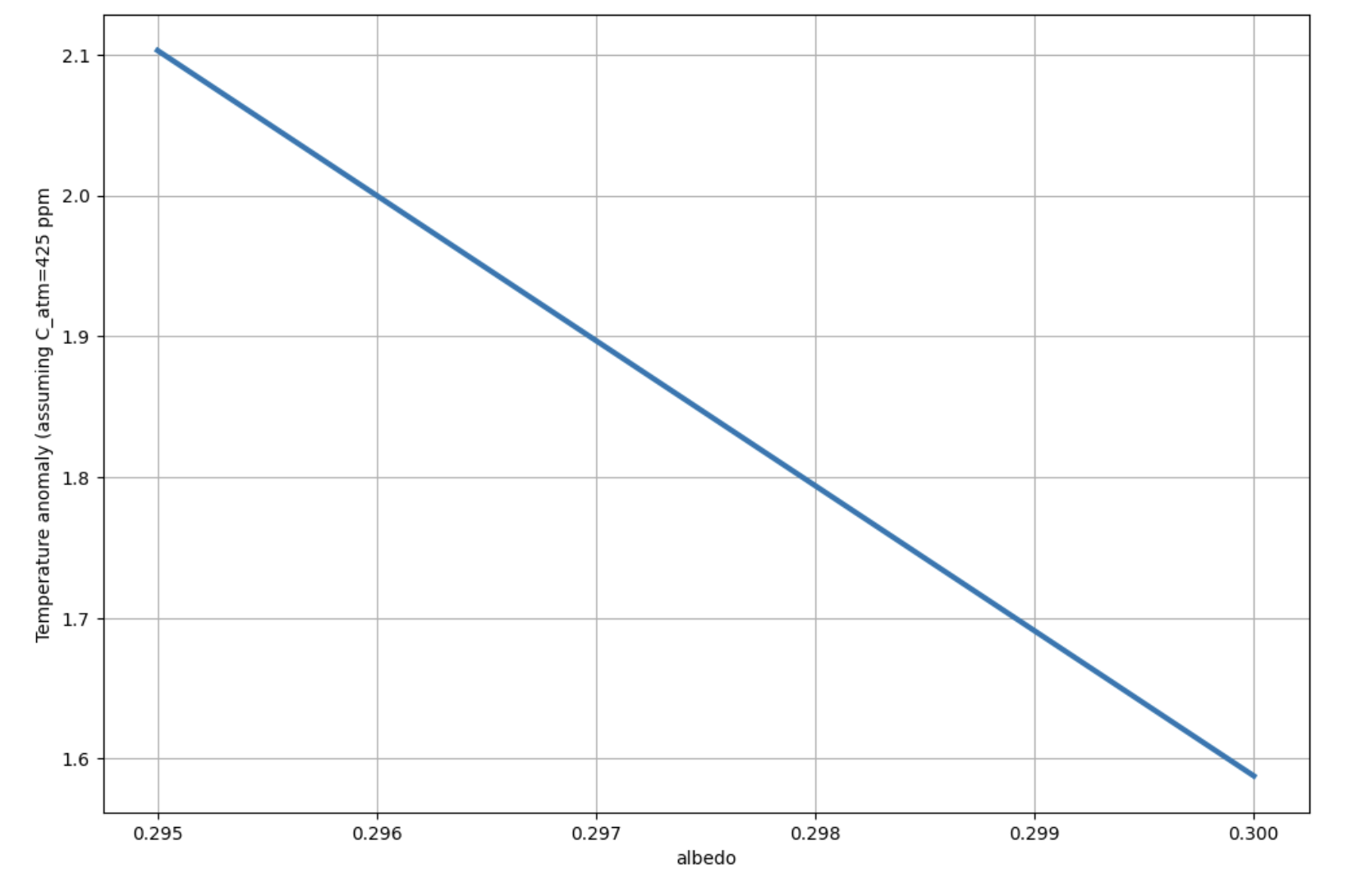


Code, graphics, and math of Step 3 …
Here’s the code we just saw
Here’s what it does graphically
Here’s what it does mathematically

Slide 8
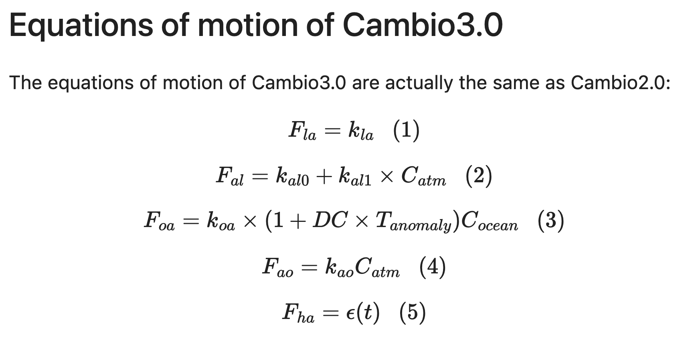
OK, let’s get started

Slide 9


Ice/albedo feedback handout

